Slide 1


Digital Services Review and Planning Session
December 2015
©2015 SmartCook Energy Limited | CONFIDENTIAL – DO NOT DISTRIBUTE

Slide 2
Objectives for today
Share market research and exploration done to-date on digital services platforms
Agree on prioritization of digital services offerings for SCE to pursue
Align on work plan and resource needs to develop priority offerings

Slide 3
AGENDA
Digital Services exploration approach
Domain Prioritization
Financial Services
Market context and work to date
Project plan
Advertising
Market context and work to date
Project plan
Media
Market context and work to date
Project plan
Information Services
Market context and work to date
Project plan
SCE Consumer Videos Project Update

Slide 4
AGENDA
Digital Services exploration approach
Domain Prioritization
Financial Services
Market context and work to date
Project plan
Advertising
Market context and work to date
Project plan
Media
Market context and work to date
Project plan
Information Services
Market context and work to date
Project plan
SCE Consumer Videos Project Update

Slide 5
Key Principles For Digital Services Exploration
We are a B2B platform, not a B2C conglomerate
We will seek those digital services opportunities that DERISK and ADD VALUE (through creating an alternate revenue stream) to the FuelPoint network investments required to service cooking energy demand
Our focus is on significantly improving Urban Access and Consumer Experience for EXISTING well-funded corporates so that they will pay to use our network of hardware, software & ‘agents’
We follow an iterative, field-based approach to market exploration: hypothesis, test, iterate, test, iterate using field sites and demo/test customers
We will not jeopardize the cooking energy offering
We will prioritize partnerships in lines of business that require no regulatory innovation

Slide 6
Our assets: What we can offer to potential partners
Fuel Point Network: A “public smartphone” for lowest income groups, or a piece of infrastructure enhancing capabilities of smartphones
Internet connected
Power connected with backup
Display and touch screens for customers to view and interact with
Known location
Can interact with smart devices over local wifi, reducing cost of using smartphone and expanding functionality of smartphone (e.g., media)
Customer Relationship Management:
Customer intelligence – customer contact information, GPS location, demographics incl. estimated level of income, purchasing behavior as proxy for income
Billing system
Customer app for those with smartphones
Regular point of contact for customers
Fuel business gives us an alternative way to monetize services
A trusted brand for the urban mass market

Slide 7





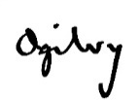



What areas did we explore?
Platform Offerings
Financial Services
Advertising
Digital Content
Information Access
E-Commerce
Consumer Product/ Service
Consumer loans
SME loans
Microinsurance
Mobile Wallet
Interactive ad during user session
Digital billboard
Broadcast
On-Demand
Download to go
Wi-Fi broadband net connectivity
Health/Education content distribution
Product research
Ordering
Payments
Fulfillment support
Value Proposition
Cheap
Easy
Reward loyalty
Fast
Secure
1:1 targeting based on profile
Interactive/signup
Localized
Exclusive material
Broad library
Relevant
Accessible
Cheap
High Speed
Accessible
Cheap
Accessible
Trustworthy
Our B2B Customer/ Delivery Partner
Local content partners
Our Revenue Model from B2B Partner
Origination Fees
Collection Fees
Ad sales
Ad views
Signups
Cut on content views/sales
Ad sales
Hosting Fees
Subsidized connectivity to Fuel Points
Conversion Fees
Custodial Fees
Why They Would Partner With Us
New customers,
Existing infra
Greater profit
Low-Cost Interactive Video Ad Platform
Low-Cost Interactive Video Platform
Existing infra and CRM
New customers
New customers,
Existing infra
Greater profit

Slide 8
AGENDA
Digital Services exploration approach
Domain Prioritization
Financial Services
Market context and work to date
Project plan
Advertising
Market context and work to date
Project plan
Media
Market context and work to date
Project plan
Information Services
Market context and work to date
Project plan
SCE Consumer Videos Project Update

Slide 9
What synergies does each DS domain have with SCE’s core business?
 | Financial Services | Advertising | Digital Content | Information Access | E-commerce
Required for core business? | Yes; stove financing | Yes; SCE will need to advertise its services on the media screen | Yes for media screen; need content to advertise SCE services No for digital content downloads | Sort of; wifi may reduce connectivity costs but mobile data is a viable solution | No
Synergies with SCE core business | -Payment system/CRM -Customer data | -Connected devices -Screens -Customer database and CRM | -Connectivity at low cost for customers -Screens | -Connectivity required for FPs -Power-connected, distributed infra -CRM | -Secure connected infra -Regular visits from staff to infra -Set of known locations
Synergy Score

Slide 10
What additional investment is required from SCE for each DS domain?
 | Financial Services | Advertising | Digital Content | Information Access | E-commerce
Additional Hardware |  | -Screen -Media drives | -Media hard drives -USB/SD reader and/or equipment for local wifi network | -Wifi APs, maximum line of sight to area -Backhaul network, likely long-range wifi | -Secure locker
Additionl Software | -Both inflow and outflow of mobile money -Integration with partner systems | -Display tracking system -Ad selection/ prioritization algorithm -Booking portal | -Media browse/ purchase interface -Content library -Mediasync back end | -Customer authentication and usage tracking -CRM integration | -Lock/unlock code system -Integration with partners -Ordering interface?
Other Additional Reqs | -Regulation around agency banking -Understand customer financial needs | -UX design -Advertiser relationships | -Relationships with content owners -Understand media preferences | -ISP license/ relationship with ISP -Additional site selection requirements | -Relationships with e-commerce partners -Additional physical and software security
Additional Reqs Score |  |  |  | Depends on nature of partnership

Slide 11
Opportunity Size - Financial Services
Savings
Loans
Per HH Stats
Per HH Stats
 | Informal | Formal | Total
Avg. Transaction per Mo. | 0.4 | 1.7 | 2.1
Avg. Turnover per Mo. (Ksh) | 407 | 2,326 | 2,733
 | Informal | Formal Personal | Business Loans | Total
Average Loans per Month | 0.6 | 0.4 | 0.1 | 1.1
Average Loan Size (Ksh) | 506 | 5,723 | 9.340 | 6,227
Estimated Monthly Revenue per FP
Assumes 200 Customer HHs
Estimated Monthly Revenue per FP
Assumes 200 Customer HHs
Avg.
Monthly Turnover
Transaction Fee
Market Share
Avg.
Loans per Mo.
Origination Fee
Avg. Loan Size
Market Share
 |  | Market Share
 |  | 15% | 20% | 25% | 30%
Transaction Fee | 0.5% | $5 | $6 | $8 | $10
 | 1.0% | $10 | $13 | $16 | $19
 | 1.5% | $14 | $19 | $24 | $29
 | 2.0% | $19 | $26 | $32 | $39
 |  | Market Share
 |  | 5% | 10% | 15% | 20%
Origination Fee | 0.5% | $2 | $4 | $5 | $7
 | 1.0% | $4 | $7 | $11 | $15
 | 1.5% | $5 | $11 | $16 | $22
 | 2.0% | $7 | $15 | $22 | $29
Note: excludes mobile money and loans/credit; don’t consider these addressable savings mechanisms
-ROSCAs and ASCAs included in “formal”
-Calculations are weighted averages of many savings mechanisms
Note: Business loan types included are “personal ag/business, supplier credit, group enterprise loan”; these loan types vary in size, respectively 9k, 1.5k, and 100k Ksh
-Personal loan mechanisms could be used for business purposes
-Calculations are weighted averages of many loan mechanisms

Slide 12
Opportunity Size – Advertising
In-Purchase
Media Screen
Estimated Monthly Profit per FP
Estimated Monthly Profit per FP
67 visits per day
Price per slot
% slots sold
15% Agency Discount
2,880 slots per month
Price per slot
% slots sold
50% margin
 |  | Viable Slots Sold
 |  | 40% | 45% | 50% | 55%
Price per Slot | $0.05 | $34 | $38 | $43 | $47
 | $0.10 | $68 | $77 | $85 | $94
 | $0.15 | $102 | $115 | $128 | $140
 | $0.20 | $136 | $153 | $170 | $187
 |  | Viable Slots Sold
 |  | 30% | 35% | 40% | 45%
Price per Slot | $0.02 | $9 | $10 | $12 | $13
 | $0.04 | $17 | $20 | $23 | $26
 | $0.06 | $26 | $30 | $35 | $39
 | $0.08 | $35 | $40 | $46 | $52
Assumes 200 customer HHs per FP, 67 customer purchases per day
Assumes 12 hours of operation per day, 8 30s slots per hour (US TV format has 16)
Assumes 50% of margin due to media costs
Margin assumptions conservative; conversations suggest amount given to content owners could be as low as 10%

Slide 13
Opportunity Size – Media Downloads
$6.55
Average HH spend on purchased media
25%
HH with digital media-enabled devices
200 HHs
Per Fuel Point
$327
Monthly addressable spend per Fuel Point
 |  | SCE Share of Spend
 |  | 10% | 15% | 20% | 25%
SCE Margin | 50% | $16 | $25 | $33 | $41
 | 60% | $20 | $29 | $39 | $49
 | 70% | $23 | $34 | $46 | $57
 | 80% | $26 | $39 | $52 | $65
Note: SCE can monetize in ways which access spend beside shown in this opportunity sizing: additional in-purchase advertising, promotional

Slide 14
Opportunity Size – Information Access
600 Ksh
Estimated HH spend on wifi service
SCE Share of Spend
% of HH with Smartphones
 |  | HH Smartphone Ownership
 |  | 10% | 20% | 30%
Share of Spend | 20% | $24 | $47 | $71
 | 25% | $29 | $59 | $88
 | 30% | $35 | $71 | $106
 | 35% | $41 | $82 | $123
This sensitivity table shows potential revenue for ISP, but SCE would likely receive only part of this revenue, or see this benefit as a reduction in data costs

Slide 15
Overall Domain Scoring
 | Financial Services | Advertising | Digital Content | Information Access | E-commerce
Synergy Score
Additional Reqs Score
Estimated Monthly Opportunity per FP | $20-$40 | $77-$128 for in-purchase $20-35 for Media Screen ads | $29-46 for downloads $20-35 for Media Screen ads | $60-70 Opportunity for ISP, SCE opportunity smaller | Not estimated
Complementary Opportunities

Slide 16
AGENDA
Digital Services exploration approach
Domain Prioritization
Financial Services
Market context and work to date
Project plan
Advertising
Market context and work to date
Project plan
Media
Market context and work to date
Project plan
Information Services
Market context and work to date
Project plan
SCE Consumer Videos Project Update

Slide 17
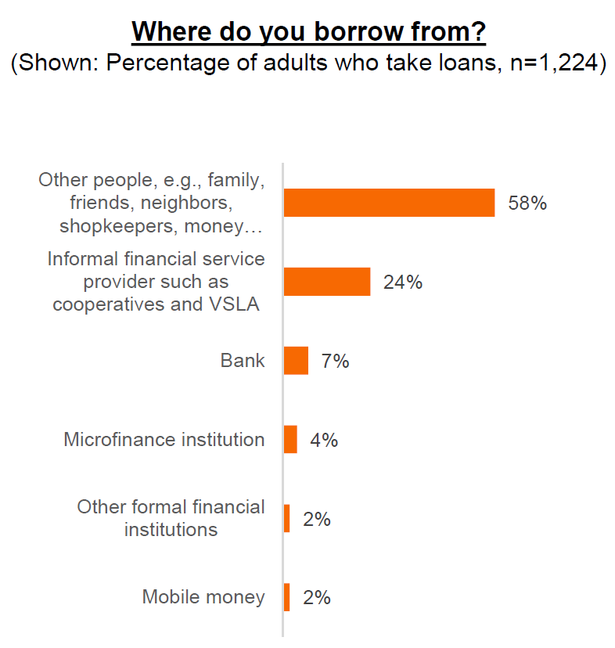
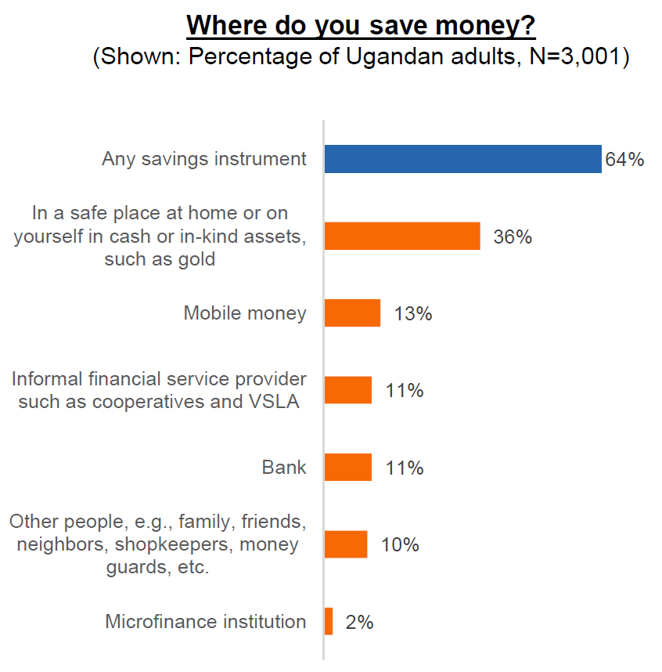
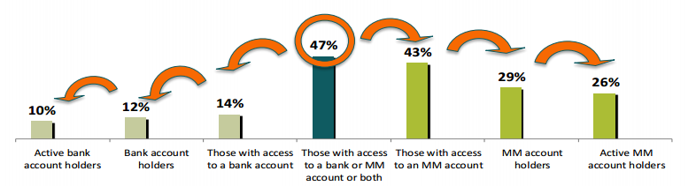
Market overview: Opportunity to leverage mobile to expand access to financial services
Low usage of formal financial institutions to save and obtain credit
…particularly by those in the lower wealth quintiles
Three times as many Ugandans have access to a mobile money account than to a bank account
Source: Finscope (2013), Intermedia Uganda Year 2 Report, Financial Diaries Kenya

Slide 18
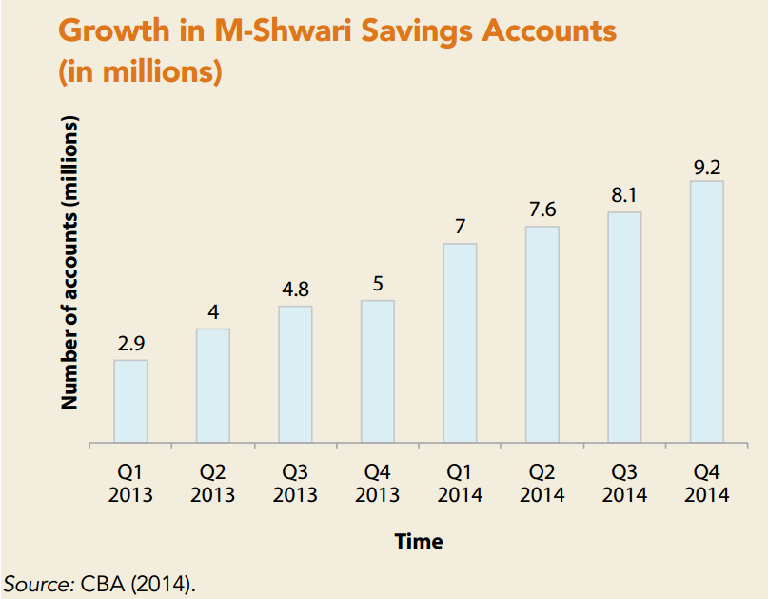
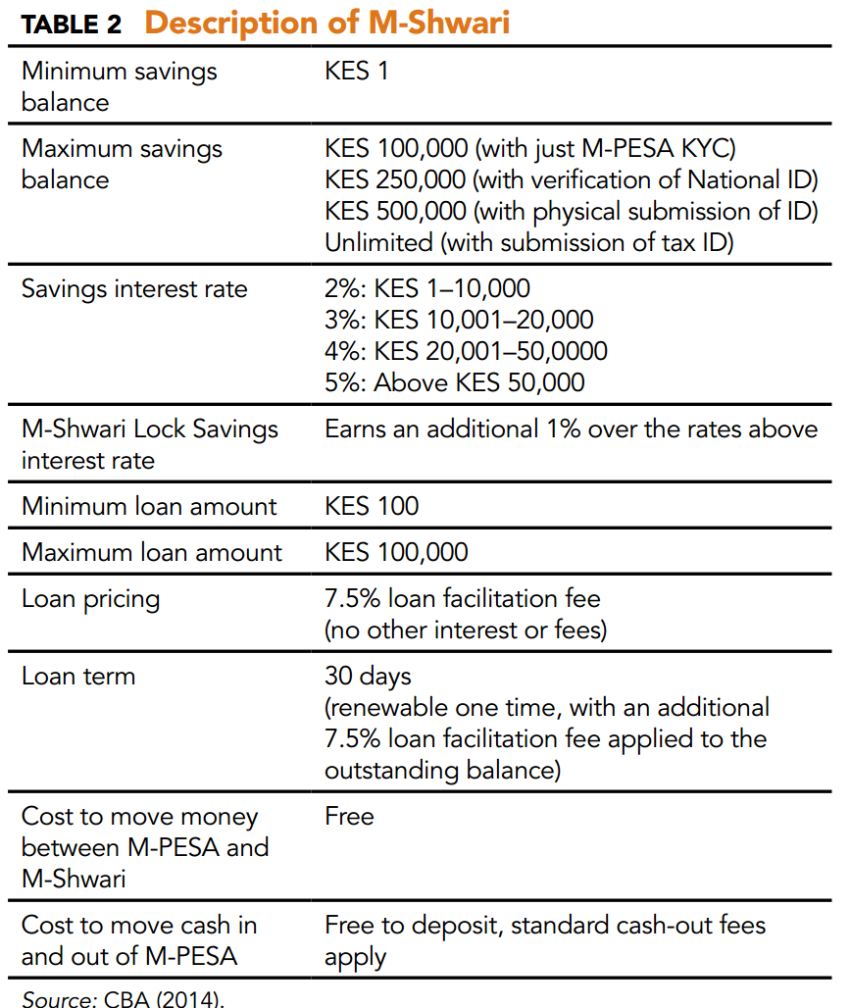
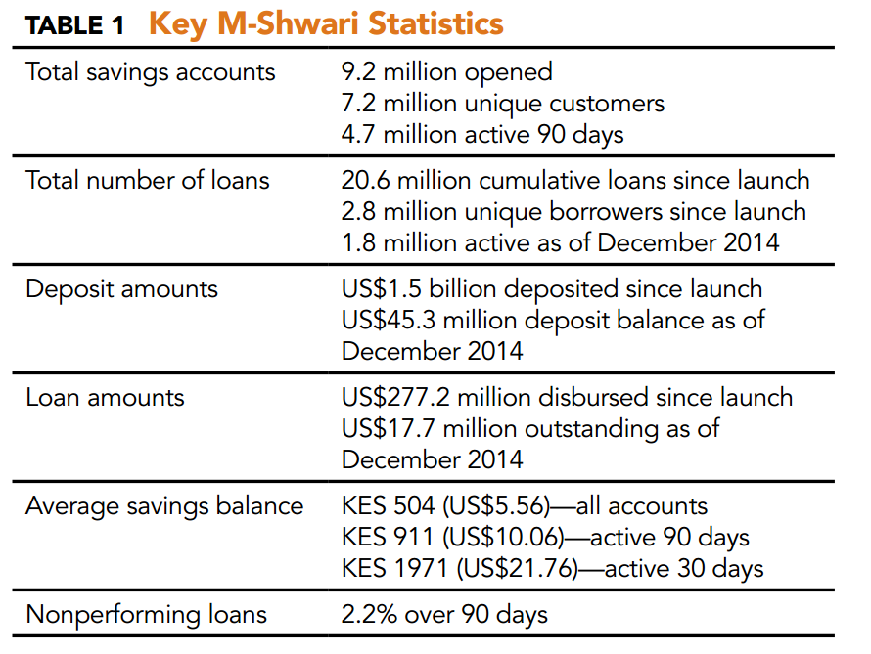
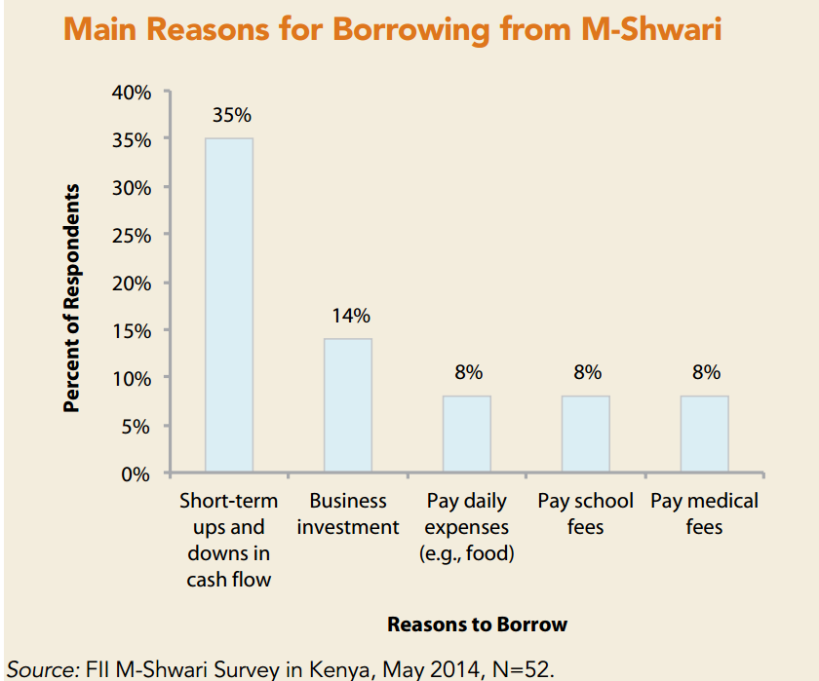
Market overview: Example of m-Shwari

Slide 19










Market overview: Key Players
Financial services providers
Digital financial services providers

Slide 20
What role can SCE play in providing financial access?
Least intensive
Most intensive
Advertising
FSPs place advertisements on the fuel point
Revenue: advertising fees
Distribution
Product suite used to expand access to existing financial products (e.g., apply for loan on FP)
Revenue: origination / collection + advertising fees
Innovation partnership
SCE and a FSP develop a new product (e.g., stove loan) offered through the SCE product suite
Revenue: TBD
Independent innovation
SCE develops and finances a new product (e.g., loan) that is offered through the SCE product suite
Revenue: Interest + other fees
FP as a marketing channel
FP as a marketing channel
FP as a marketing channel
FP as a marketing channel
FP as a distribution channel
FP as a distribution channel
FP as a distribution channel
SCE develops products
SCE develops products
SCE finances products
Digital services takes the lead
Digital financial services takes the lead and coordinates with digital services

Slide 21
Which types of (digital) financial services are most logical for SCE to pursue?
Offering type | Description | Current offerings | Thoughts on opportunity size | SCE ability to address
m-Wallet | Mobile-based virtual wallet where you preload a certain amount in your account and spend it at merchants listed with the m-wallet service provider | m-Pesa MTN Mobile Money Kopo Kopo (payments using existing m-wallets) | Existing m-wallets have considerable customer base (particularly in Kenya) and backed by MNO Easy to set up mobile money account | Low: Cannot compete with existing offerings but SmartCook Money is a mobile wallet – could integrate with m-Pesa or other providers
Savings | Banking product that allows you to save money using your mobile phone and m-wallet account | m-Shwari m-Pawa | Most m - wallet services have linked savings product More research needed to understand reach and sophistication | Medium: Cannot compete with m-wallet savings offerings, but could innovate around FP as a distribution channel. Can also explore integrating SmartCook Money with a financial product
Loans / line of credit | Banking product that allows you to borrow money using your mobile phone and m-wallet account | m – Shwari L-Pesa Grow (Kopo Kopo) | Recent increase in activity Largely untapped - opportunity to scale existing products Limited linkages between FSPs and MNOs | Medium: Could innovate around FP as a distribution channel and data offering. Can also explore integrating SmartCook Money with a financial product
Insurance (health, life, agriculture) | Customers put aside small sums of money (leveraging m-Pesa) to purchase insurance coverage | BIMA Changamka | Opportunity to scale products or develop more relevant products | Low: Not a part of SCE core business / low synergy; complex to structure / underwrite

Slide 22
AGENDA
Digital Services exploration approach
Domain Prioritization
Financial Services
Market context and work to date
Project plan
Advertising
Market context and work to date
Project plan
Media
Market context and work to date
Project plan
Information Services
Market context and work to date
Project plan
SCE Consumer Videos Project Update

Slide 23
Financial Services Exploration Workplan
Need to discuss plan for core financial services offerings (stove financing, FP host loans) and nail down areas of responsibility
Fill in rough timeframes

Slide 24
AGENDA
Digital Services exploration approach
Domain Prioritization
Financial Services
Market context and work to date
Project plan
Advertising
Market context and work to date
Project plan
Media
Market context and work to date
Project plan
Information Services
Market context and work to date
Project plan
SCE Consumer Videos Project Update

Slide 25
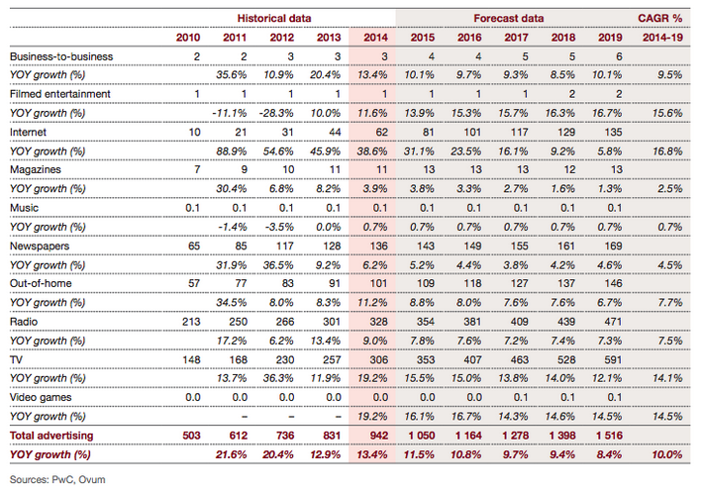
Market overview
Kenya Advertising Market Size ($M)

Slide 26
OOH Market Overview
OOH Market Size in Kenya $M
CAGR
Projections
7.7%
2.9%
31.6%
Digital OOH is a small market in Kenya with spend of $10.8M
Among the fastest growing ad types with a CAGR of 31.6%
Digital OOH platforms seek to solve problems OOH faces in Keny as well as globally: lack of interactivity and poor monitoring ability
Growing demand for interactive OOH platforms
Source: PWC

Slide 27










Agency Overview
Kenya
57% of ad spending goes through agencies
Dentsu Aegis Network
70-80% Market Share
Partnership
Uganda
Dentsu Aegis Network
Controlling Market Share

Slide 28
Pricing
 | Kenya | Uganda
 | Total ad price | Total ad price
Digital Display | Online news sites: $2,940 - $5,290 /month; CPC: $1 | Online news sites: $100 - $500
Digital Video | Youtube: $0.10 - 0.30 per view
Print | $530 - $6,200 | $300 - 3,000 per month (median of $700) $0.16 – 2.67 per view
TV | 15’’: $405 - 881 30’’: $793 - 1762 45’’: $1035 - 2645 60’’: $1371 – 3525 Per spot | 15’’: $23 - 107 30’’: $50 - 164 45’’: $55 - 238 60’’: $62 – 302 Per spot
Radio | 30’’: $195 - 343 45’’: $367 - 515 60’’: $392 – 686 Per spot (excludes 16% VAT; 20% discount for packages) | 30’’: $12 - 16 45’’: $16 - 33 60’’: $22 – 39 Per spot (Excludes VAT / surcharge; 30% discount for packages)
Billboard | 12 x 10: $1762 12 x 20: $3912 24 x 8: $4897
Other | Flyers: $0.05 – 0.07 per flying (excludes labor) SMS: $0.01 per message
$ / view is difficult to determine as many providers do not track or share numbers around reach

Slide 29
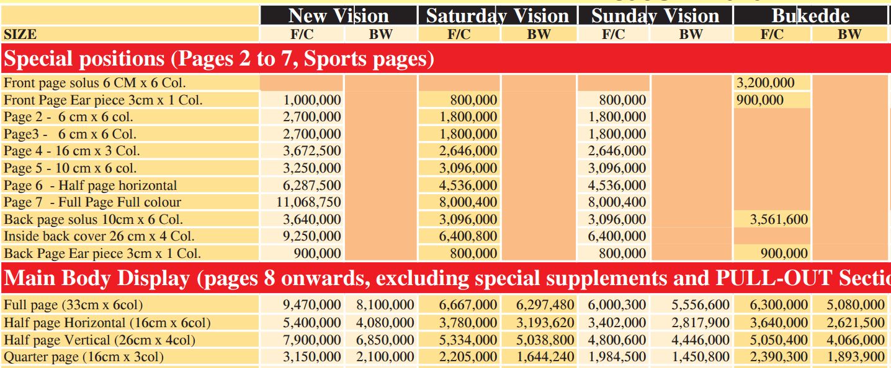
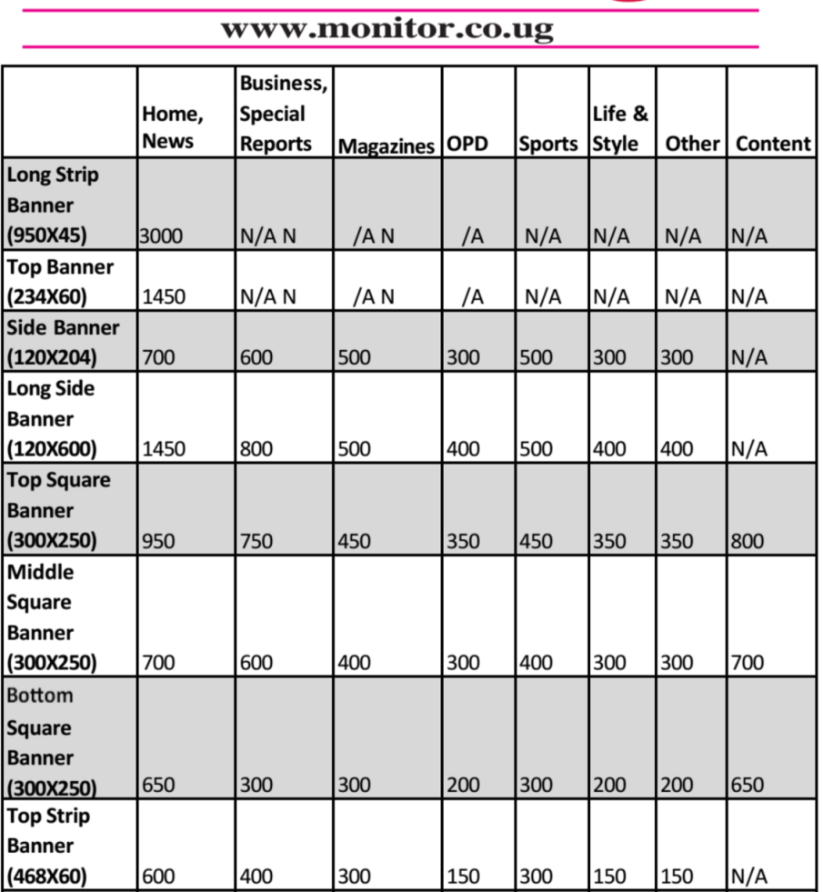
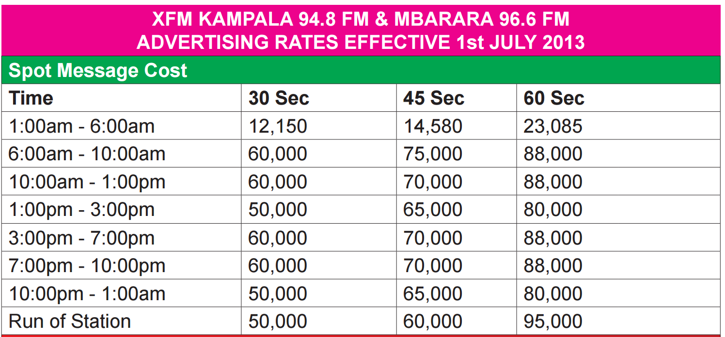
Uganda: Examples of pricing
USD / month

Slide 30


Pioneer Transit Media
Key Features:
Reach is ~100,000+ per day
Captive audience for 45 minutes on average
Audio included
Content Plan:
Content to run on a loop of 1 hour
Each ad played twice during the hour
Ads to occupy 50% of the loop
Content includes news highlights, sports, fun facts, music videos
Price: ~$0.06 per display per bus

Slide 31
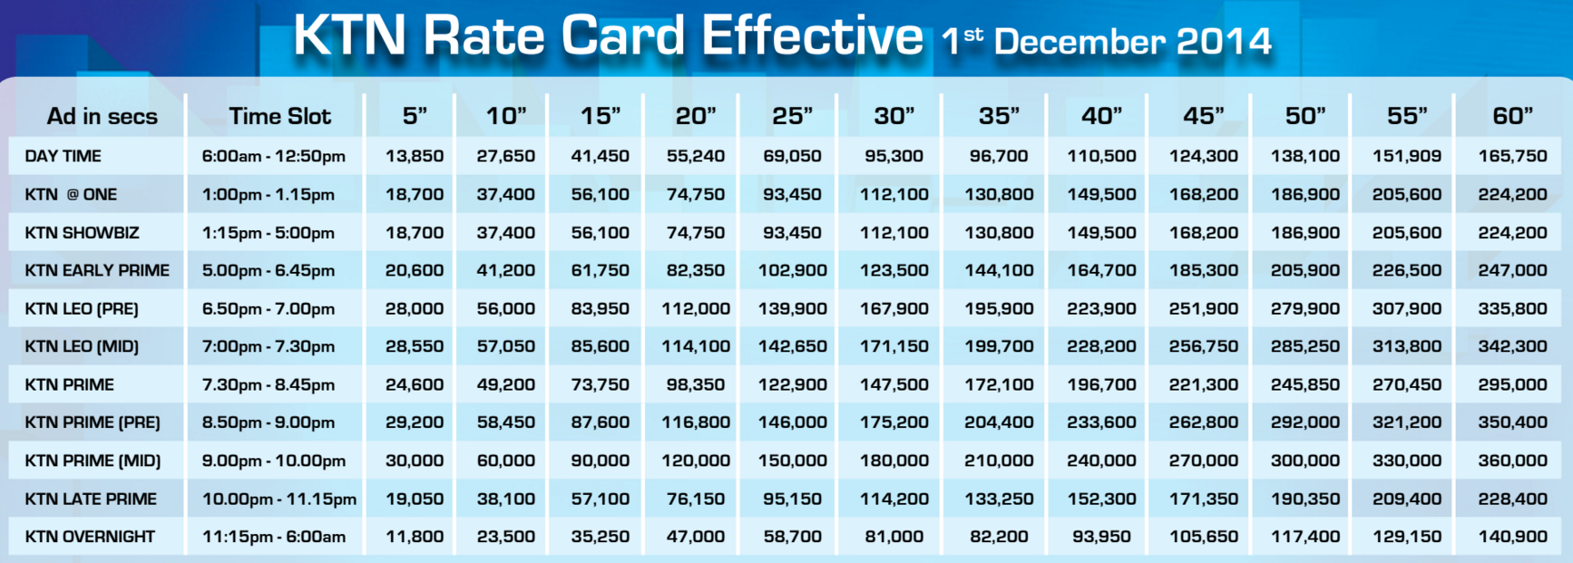
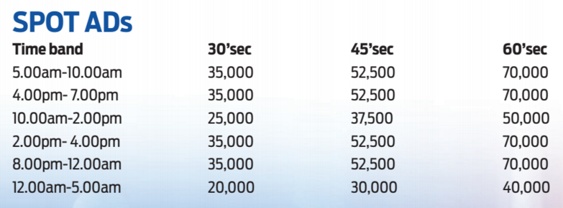
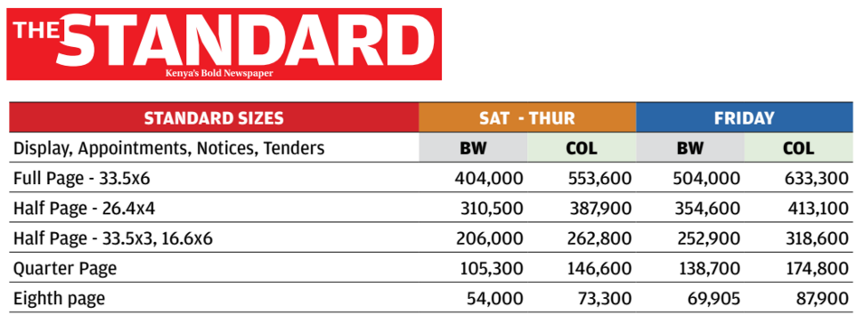
Kenya: Examples of pricing

Slide 32
Advertising: Customer Segments
Segment
Advertising channel
1)Consumer goods companies
Promote a specific product / brand found in multiple locations
1a: Multinational consumer goods companies - e.g., PepsiCo, Unilever, P&G, MTN
1b: Local consumer goods companies - e.g., Movit, Centenary Bank
2) Government / bi-lateral donors
Provide education or create a call to action
e.g., URA, NRM, USAID
3) Traditional SMEs
Promote their service / product, typically sold at a specific retail location(s)
e.g., pharmacies, legal services, vocational education, travel agencies, specialty health and beauty products, driving schools, etc.
4) NGOs / social enterprises
Target middle / lower income East Africans with a product, service or education / messaging
e.g., PendaHealth, Jibu, Bima, SafeBoda, AfriPads, DumaWorks
Large media agencies: TV, Radio, Billboards, Print, In-Person (at events), Online
Large media agencies: TV, Radio, Billboards, Print, In-Person (at events), Online
Little to no advertising – primarily through word-of-mouth or location / convenience: Flyers, Facebook, In-Person (exhibitions)
- Cost is a key barrier and lack of knowledge about marketing. Education required and low willingness to pay
- SE budgets ~5,000 KES / month and 200,000 UGX / month
- Target market of many SMEs (e.g., handicrafts, car parts, etc.) might not be best reached by our FPs due to the nature of the products and only having 1 - 2 locations
In-house advertising capabilities though limited budget: Online, Flyers, In-Person (at events), through partners

Slide 33
Initial Reactions and Requirements
General Concept:
Advertisers have shown strong initial interest in the platform
Consider it to be direct competition to TV and print in reach and cost
Features:
Want to advertise on the larger media screen, not on the touch screen. We should black that out when ads are playing to not distract the viewer
Keep the initial offering basic since the platform itself is a new concept – i.e. focus on ads vs. other engagement (e.g., SMS) tactics
Find web portal valuable, particularly the dashboard that displays metrics that an agency can present to their clients
Pricing:
Interest is strongest in in-purchase ads due to ability to target
Targeted ads could net $0.10-0.20 per display (Natasha, Carat)
In-purchase ad prices determined by demographics available, degree of targeting – matrix of groups which can be targeted with a price per view increase with each
Media screen ad pricing determined by number of views and demographics of viewers – charge a monthly fee for a projected # of viewers / # views per day
Can charge a premium for playing during peak periods vs. subsidize to play during "off periods“ – rate card similar to TV ads with prime time, day time, evening, etc.
50 - 60% are targeted ads that are played when a consumer purchases and remainder are generally playing for passersby
Agencies want the ability to negotiate price for bulk buys
Key Metrics:
Limited sophistication in monitoring / data gathering – typically do not attempt to measure effectiveness
Want to know # of times the ad plays and projected reach. Any additional demographics would be helpful
More sophisticated advertisers interested in selecting groups of Fuel Points, so target FPs in certain neighborhoods, those in grocery stores vs. salons, etc.

Slide 34
Advertiser portal functionality requirements
1. Registration of advertisers:
Unique log-in ID / password for an advertiser (agency, business, other organization) to access web portal
Record profile information (organization name, contact name, email, phone number for key contact)
For advertising agencies, is it possible for one agency to have different sub-accounts they can choose from to perform activities 2 - 4, since they might be advertising on behalf of a few organizations? (e.g., MaaD Media can select a tab for USAID, Movit, Unilever, etc.)
2. Media upload and campaign management:
Ability to upload and view video clips
Select target demographic for distribution and for tracking
Gender (M / F / all)
Age (< 18, 19 - 29, 30 - 59, 60+, all)
Location of kiosk (kiosk category to be determined -- e.g., “smaller, more local” kiosk in hair salon vs. “larger,, more urban” kiosk at petrol station)
Income (e.g., based on average fuel purchase amount per week)
Based on demographic specifications, advertiser will get an estimate of how many people they will reach
Open question as to how customer will “engage” - customer selects the ad they want to see (almost like a juke box), customer says if they liked the ad, etc.
Select length of run (start date and end date or indefinite end date)
Goes for approval to the SCE Digital Services team
Once approved, will be uploaded to relevant kiosks to play
Ability to archive video clips
Archive videos after the length of the campaign is over but advertiser still view the video and campaign statistics
3. Selection and tracking of “success” and “impact” campaign metrics:
On-going tracking via a dashboard (basic: table, advanced: graphics)
Aggregate statistics on total number of viewers for each clip
Cut by demographic
Daily or weekly email updates, if they select the option
4. Tracking of costs and payment
“Invoice” feature - base fee, cost / viewer, etc. for them to have an idea of the total cost of campaign
Ability to pay online

Slide 35
Potential partnerships
Partner name | Status | Next Steps | Details
Posterscope | Initial meeting, showed strong interest | Share information about media screen testing plan | OOH-focused agency in Dentsu-Aegis network. Potentially valuable advisor as well as sales partner.
Havas | Initial meeting | Share information about media screen testing plan | Potential ad sales partner, largest non-Dentsu agency in Kenya
Kenya
Partner name | Status | Next Steps | Details
Fireworks | High interest | Need to go back with details on offering and pricing (Feb 2016) | Relevant clients: USAID, Uganda Health Marketing Group - NGO, Shoprite, Pepsi, Zuku, Umeme, Centenary Bank, EFC Microfinance, Marie Stopes, KCCA, Movit, Mukwano, Nile Breweries (if we can filter for 18+), Uganda Mobaati, MTN
Maad | Seemingly interested but relationship is dificult | Potentially set up site visit to maintain interest Return in March with more information | Movit (haircare) brand and other appropriate client
Carat | Advisory relationship | Share info on media screen testing plan | Not many relevant clients, but valuable advisory role
Camouflage | Ghosted | Return in March with more information | Got some valuable information from them, potentially an ad sales partner
Uganda

Slide 36
AGENDA
Digital Services exploration approach
Domain Prioritization
Financial Services
Market context and work to date
Project plan
Advertising
Market context and work to date
Project plan
Media
Market context and work to date
Project plan
Information Services
Market context and work to date
Project plan
SCE Consumer Videos Project Update

Slide 37
Remaining key questions
Goals:
Develop pricing structure for advertising
Determine media screen requirements
Areas to explore:
What are typical marketing budgets for the prioritized advertising customer segments?
What demographics and viewership numbers are possible for advertisng on the fuel point? How does this differ by location and type of screen
What data do customers (ad agencies, companies) want?
How will customers want to book? What should a booking portal look like?

Slide 38
Work plan
January
February
March
April
May
June/
July
Gather viewer demographics and sensitivities to media screen placement and size
Prepare materials to share with ad customers
Overview of ad opportunity (“our pitch”) – compelling presentation detailing offering, reach
Portal wireframes for user testing
Hold focus groups / workshops with ad buyers and experts
Finalize consumer-facing ad format
Finalize ad customer portal
Determine reasonable pricing for all ad types
Ad back-end development
(tech. dev.) – MVP already in progress
Syncs ads to FPs
Selects ads to prioritize/display
Tracks ad displays and other metrics
Develop customer web portal (tech. dev.)
Book paying ad customers by test launch
User stories and requirements

Slide 39
Resources required
Discuss tech dev timeline and resources
Proposing Red Panda continues to develop back end, we bring in another web + Android developer to build user portal based on user requirements

Slide 40
AGENDA
Digital Services exploration approach
Domain Prioritization
Financial Services
Market context and work to date
Project plan
Advertising
Market context and work to date
Project plan
Media
Market context and work to date
Project plan
Information Services
Market context and work to date
Project plan
SCE Consumer Videos Project Update

Slide 41
Market Overview – Video in Kenya
Video Market in Kenya $M
CAGR
10.6%
Piracy and digital video are taking share from physical video sales
41.3%
13.6%
2.8%
-0.4%
10.8%
Digital Video Market in Kenya $M
41.3%
13.8%
-
Source: PWC

Slide 42
Market Overview – Music in Kenya
Recorded Music Market in Kenya ($M)
CAGR
8.2%
-7.2%
18.1%
-0.8%
Mobile revenues are PRSP services – ringtunes etc.
Streaming is projected to be very small (~$30k by 2019) but growing quickly (~40% CAGR)
Limited number of services available – Mziiki and Deezer seem to be only streaming apps in Kenya and have limited users
Both existing services operate on freemium model
-
Source: PWC

Slide 43
Market Overview – DVD Consumption
Household Hours Spent Watching DVDs Daily
How much do you spend on DVDs per week?
By Neighborhood
Additional details

Slide 44
Market Overview – Music Purchasing
How do you acquire the music you listen to?
31% of smartphone owners download music as their primary method of getting music
Respondents in lower-income neighborhoods are more likely to listen to music socially; significantly more listen to music at a friend’s house or get music from friends
Additional details

Slide 45
Market Overview – Media Devices
Which devices do you have that take USB or SD cards?
By neighborhood
Neighborhood
~25% of Kitintale owned a USB or SD enabled device as of November 2014; much lower for lower-income neighborhoods
DVD player was the most common device
Additional details

Slide 46
Market Overview – Pirate Media Shops
In Kenya, local content is restricted by copyright police, so media shops only sell international content. Small roadside kiosks sell DVDs/CDs of legal content purchased in town for 100 Ksh
Local content is not restricted in Uganda
Shops do not carry any educational or how-to content; most will provide animations and other children’s content on demand, but it isn’t popular
Soft copies of movies are 30 Ksh in Kenya, 1,000 Ugx in Uganda (slightly cheaper than Kenya)
Music soft copies are 5 Ksh per song in Kenya, 200-300 Ugx in Uganda (comparable pricing)
DVDs are 40-50 Ksh in Kenya and 1.5k in Kampala (comparable pricing)
Strong interest in local and other African music in both Uganda and Kenya
Strong interest in local and other African video content in Kenya; in Uganda local video content is not at a level of quality where it is sought after but people enjoy other African content
In both Kenya and Uganda, content seems to be sold ~50/50 split between hard copies (DVDs) and soft copies (Most often USB, also SD cards)
Soft copies are usually consumed on USB-enabled DVD players, but SD cards are also consumed on smartphones
More detail here

Slide 47
Market Overview – PRSP Music Sales
PRSPs are IT firms which provide content services over SMS or USSD interfaces
Test services: jokes, pick-up lines etc.
Music services: ringtunes, song downloads
Video services: short comedy clips
Service signups and purchases are paid for through customer airtime
Majority of music content seems to be local and gospel
Sales have fallen dramatically since 5 years ago – PRSPs are struggling to monetize content libraries
Reputations hurt by shady customer signup practices, copyright suits
Safaricom instituted strict requirements for signup processes
Superior pricing at pirate shops
PRSP Music Sales Revenue Share (Ksh)

Slide 48
Market Overview - Licensing
Video
Music
Licensing fees depend largely on deal terms (exclusive vs. non), if content has been aired before, where it has aired
Content that has aired before or shared digitally much cheaper
Licensing fees can run $5-10k for a first run of a TV series episode
Ad revenue share deals are also used in some situations
Some content aggregators/distributors exist, e.g., CCD Africa
One expert believed we could negotiate an ad revenue share deal as low as 10%, but needs confirmation
Musicians seem to be comfortable with 10-15% revenue share
Aggregators such as PRSPs have put together libraries for licensing, but will require additional % share and generally do not have exclusive deals

Slide 49
Media distribution – partnerships
Partner name | Status | Details
What's Good Studios | Producing brief for advisory + other services | Potential ad buyer and content partner; potential advisor on creation of media services
Liberty Afrika/Xpedia | MoU and NDA shared | Content partner for pilot, interested in both media screen and download services
Tafsiri Group | Waiting on launch of Haiya streaming video service | Potential content partner post launch of Haiya
RoamTech | MoU and NDA shared | Content partner for pilot, interested in both media screen and download services
Kenya
SMS One | Gone cold | Content partner; other room to collaborate
PVI | Open to us using media | Content partner; social marketing ad buyer
Uganda

Slide 50
AGENDA
Digital Services exploration approach
Domain Prioritization
Financial Services
Market context and work to date
Project plan
Advertising
Market context and work to date
Project plan
Media
Market context and work to date
Project plan
Information Services
Market context and work to date
Project plan
SCE Consumer Videos Project Update

Slide 51
Working concept
Media screen - playing a mix of media and advertising on media screen
“TV channel” concept: passive loop of media and ads. Currently in testing
“Jukebox” concept: passersby can select videos to play. Passive loop plays when none are selected. Ads can be semi-targeted based on types of clip.
Media download service - customers can browse, pay for, and download content at Fuel Points
Several potential ways to monetize: through direct customer payments, promotional (offering free media after buying X liters of fuel), showing an ‘in purchase ad’ while music is downloading
Brck partnership

Slide 52
Remaining key questions
Media screen display - document on questions here
How much will content cost?
How do we obtain necessary performance licenses in bulk?
What is the best screen layout? Does the screen need to be facing outside for a compelling business case?
What screen size is necessary?
What media will draw the most eyeballs?
Media download
Will video content owners be comfortable with making files openly downloadable?
How much revenue will need to be shared with content owners on each sale?
How much will people be willing to pay for media?
If media is offered on a promotional basis, what lift in sales can we expect?
Will people be comfortable purchasing on kiosk?
Brck partnership
Will user numbers at our sites be compelling for Brck?
Does Brck distract from our media platforms?
Financial arrangement with Brck?

Slide 53
Work Plan – Media Screen
January
February
March
April
May
June/
July
Develop “Juke Box” concept MVP software
Test “Juke Box” concept
Interface on touch screen allowing passers-by to browse media library
Plays selected videos on media screen
Put “Juke Box” media screen concept in field and observe user reactions
Checking for lift in engagement, feedback from advertisers
Perform legal due diligence
Obtain licenses for media and book paying ads by test launch
Breakdown of licensing costs
Plan for obtaining licenses (especially in bulk for full rollout)
Conduct basic media screen testing
Final decicsion on media screen format
Understand potential viewer footfall and demographics
Determine ideal media screen size and placement

Slide 54
Work Plan – Screen Field Testing Detail
Objectives:
Determine ideal media screen specifications (i.e. size and placement) and the resulting impact on customer engagement
Gather data to provide to potential advertisers regarding viewership (footfall, demographics, etc.)
Understand media preferences of our target demographic
Summary of Field Activities:
Field activity 1: Market sizing / viewership potential
1a - Observation of FP activity: What viewership (footfall, demographics, customer vs. non-customer, etc.) do we expect?
1b - Viewer questionnaires: What viewership (footfall, demographics, customer vs. non-customer, etc.) do we expect? What are their media preferences?
Field Activity 2: Screen size and placement testing
2a - Screen size tests: What size screen is optimal?
2b - Screen placement tests: Does the screen need to face towards the street, or can it be placed inside some or all FP host businesses (to attract non-customers)? → Outcome will determine if worth testing “hole in the wall” fuel point concept
Field activity 3: Media format testing: Which media types are most popular and what is the best mix of entertainment and advertising? With which demographics?
https://docs.google.com/document/d/1exOupZh8Tr0Dd9JybgaXmpzZ0PmXVu72916A38ZskWU/edit

Slide 55
Work plan - Media download
Develop media download MVP, interface and hardware - Starting ASAP, ideally coplete by Mid-March, could use input on timeframe and staffing here
Allow customers to browse, buy, download a small media library on Fuel Point
Payment through SCE account, promotional offers (free after X liters of fuel)
Initial promotional sales lift testing - Feb 2016
Offer customers a selection of media every X liters of fuel
No tech dev yet, can offer download links through PRSP partners or even just give to customers in person
Make a variety of media available
Media purchase testing – ideally mid-March (whenever tech development finishes)
Sell small library of media to customers
Continue to offer media on promotional basis, test promotional abilities
Test a variety of prices, types of media
Complete media download LoB financial model – Mid April
Allows go/no go decision on media download business, which determines media distribution hardware requirements (if any) for soft launch in June

Slide 56
Work Plan – Brck Partnership
Brck partnership
Switch to different Fuel Point location when demo FPs roll out (Late Feb)
Review data, discuss future plans with Brck – Mid April

Slide 57
Resources Required
Coding – probably need 3rd party dev
Enhanced media screen concept
Media download rig
Media screen field testing
1 research analyst / field assistant
2 temporary research analysts / field assistants
Media library
6 - 8 screens of varying sizes to be placed outdoor (in window facing street) and indoor (inside salon)
Some budget for content rights purchase – direction on how much we’re comfortable with
Depends on deals for pilot I am able to get with content owners, most content partners likely to provide for free
Haiya/Tafsiri group content will likely require a small fee, will try to keep this under $1,000
Legal due diligence – what is required here? Timing and personnel?

Slide 58
AGENDA
Digital Services exploration approach
Domain Prioritization
Financial Services
Market context and work to date
Project plan
Advertising
Market context and work to date
Project plan
Media
Market context and work to date
Project plan
Information Services
Market context and work to date
Project plan
SCE Consumer Videos Project Update

Slide 59
Market overview
Internet Access Spend in Kenya, $M
CAGR
20.9%
Projections
Source: PWC

Slide 60
Market overview – Smart Device Access
Internet Device Ownership and Usage Summary
Kitintale Residents Only
Other Neighborhood Internet Device Ownership
Other Neighborhood Total With Internet Access
3%
2%
Household owns internet device
Household does not own internet device
A total of 14% of respondent households own internet devices
Another 8% of respondents use the internet without owning a device; often through borrowing a phone or using an internet cafe
These respondents have internet devices in the household but may not necessarily be regular users
Note: Smartphone question was framed as a whole-household question while computer question was framed as an individual question
60

Slide 61
Market overview – Mobile Data Spend
Mobile Data Bundles
% of respondents who have used mobile internet
In Uganda, phones cannot access internet without purchasing bundles. In Kenya, users can browse at very high rates per MB without purchasing bundles. Work at Finlays suggests this is common
Mobile Data Spend per Week
% of respondents who have used mobile internet
5,000 UGX equates to 150-275 MB or less at daily bundle pricing

Slide 62
Market overview – Wifi Usage
Why haven’t you used wifi?
% of those who have not used wifi
49% of smartphone owners had used wifi
49% of those who hadn’t used wifi reported not finding it useful
Users may not have found wifi useful since at the time of the survey most wifi was in restaurants etc. or paid; mobile data is more convenient
Accessibility and lack of knowledge were also hurdles, particularly for those who are not smartphone owners
Smartphone in household
No smartphone in household
More details: https://drive.google.com/a/cleanstarventures.com/file/d/0B0O7-UwO06GienFFbzhpa1N6cTQ/view?usp=sharing

Slide 63
Market overview – Cyber Café Usage
Cyber cafes seem to be less common in Uganda; only one cyber cafe serving Kitintale
Kenya: 50 cents - 1 Kes per minute; Uganda 20 Ugx per minute, comparable to cheapest Kenyan cybers (sample size of only one shop)
KRC offers unlimited wifi for 150 Ksh per week; this is very popular and many people come and work from the KRC cyber
Most common applications seem to be general browsing, especially world news, football stats, FB,and Youtube; job applications and secretarial work (printing, laminating, etc.) also common
Cybers seem to get 20-50 customers per day, most of whom stay less than hour; more customers come when schools are closed and on weekends
More details:
https://docs.google.com/a/cleanstarventures.com/document/d/1elqthmDF88AYaVuZGpAtUE5n6LfYkWni9o2MwP4aGdc/edit?usp=sharing

Slide 64
Market overview – Internet Applications
What are the main things you use internet for?
% of those use mobile internet
More details: https://drive.google.com/a/cleanstarventures.com/file/d/0B0O7-UwO06GienFFbzhpa1N6cTQ/view?usp=sharing

Slide 65
Market overview – African Wifi Project Details
Project | Launch | Description | Pricing | Outcomes
Wazi/Zuku wifi (Google+Wan | Aug 2011 | Hotspots at high-end locations around Nairobi | 10 min free, 50 Ksh per device /day, 500 Ksh per device /mo. | Lots of press around launch, not much since. 90-100 locations listed
Argon Telecom Kibera Project | Late 2015 | WAN in Kibera. Also offering free content. Launching $40 smartphone next year | Purchased through scratch cards | Not launched yet
Gov-sponsored Nairobi slum wifi | Unknown | Kenyan gov promised wifi hotspots in Kibera and all Nairobi slums. | Free | Could be gov hot air.
KRC cyber cafe |  | Wifi offering at KRC cyber café | 150 Ksh per week | Popular, people come to KRC café to work
Nakuru County/ Liquid Telecom | Mar 2015 | Free gov-supported wifi for Nakuru County | Free | Ksh 300M spent on project, never worked, Nakuru county sued
Google/Roke wifi in Kampala | 2015 | Roke purchases wholesale wifi bandwidth from Google, offers in high-traffic areas | Limited free service for passers-by, but seems to be supported by paid business customers | Seems to be operating successfully in several high-end locations in Kampala
MTN hotspots Kampala | Early 2013 | 65 hotspots in locations around Uganda; seemingly high-end | Purchase MTN bundles through portal | Technical issues, most users said they could not connect
Uhuruone (Dar es Salaam) | 2010 | Network of hotspots covering large portions of Dar. Unlimited service | Vouchers for ~$0.50/ht, $1.40 /day, $18.50 /mo. Also SME ($75-150 /mo.) and enterprise plans | Successful
Ko-kasi Hotspot (SA) | 2015 | Hotspot business | 50 Mb/day free, $3.00 per day unlimited. Sell vouchers | 150-200 connections per day in 2 townships
WTP seems to be ~500-600 per month

Slide 66







Potential Partnership Models
Would be difficult for SCE to operate a wifi WAN
Massive incremental hardware, capabilities investment
Fuel Point locations not necessarily best hotspot locations – Wifi hardware may be separate from FPs
“Mobile data arbitrage” model reselling connectivity over 3G/4G routers a possibility
Could also partner with WISP interested in building wifi WAN. What can SCE offer an ISP partner?
Anchor client – SCE pays a set amount per month at a lower rate per GB than telcos, subsidizes low-cost consumer offering
CRM – Integrate SCE back end with ISP partner to handle payments. Avoids voucher systems set up by man existing projects
Infrastructure – Depending on network architecture and AP specs, FP could host wifi equipment. Initial exploration with Google indicated that infrastructure synergies may be limited, and site selection criteria is quite different
Potential ISP Partners

Slide 67
AGENDA
Digital Services exploration approach
Domain Prioritization
Financial Services
Market context and work to date
Project plan
Advertising
Market context and work to date
Project plan
Media
Market context and work to date
Project plan
Information Services
Market context and work to date
Project plan
SCE Consumer Videos Project Update

Slide 68
Work Plan For Wifi Exploration
Create summary deck/proposal – Late December
Outreach to potential partners – Early January
Goal for exploration with partners is to understand infrastructure/tech synergies, explore potential partnership formats
Longer-term work plan will depend on discussions with potential partners

Slide 69
AGENDA
Digital Services exploration approach
Domain Prioritization
Financial Services
Market context and work to date
Project plan
Advertising
Market context and work to date
Project plan
Media
Market context and work to date
Project plan
Information Services
Market context and work to date
Project plan
SCE Consumer Videos Project Update

Slide 70
Progress to date and next steps
Video | Progress to– date | Next Steps
Miniseries pilot Introduces cast of characters for an ongoing SmartCook “soap opera” Purpose: Entertain customers while educating on SmartCook services, best practices, etc. | Initial micropilot script completed (Philip Rugamba) | Awaiting quotes from a production studio in Nairobi (Tafsiri Group) to do live action shoots Finalize scripts: Early Jan 2016 Target date of completion: Late Jan 2016 (in time for demos)
Infomercial Thematic rather than educational, think a Coke commercial Purpose: Build SmartCook brand awareness and perceptions | Initial infomercial script completed (Philip Rugamba and Smitha Sharma) | Amateur 3D animator has provided quote ($500) When infomercial quotes received from live-action production studio can make a final decision and begin production (mid-December 2015) Considering an animation because an animator can use stove and other hardware renderings rather than needing a finished product Target date of completion: Late Jan 2016 (in time for demos)
Commercial Enteraining overview of key features (stove use, purchasing fuel) and benefits) Purpose: Educates potential and current customers and touches on key selling points (e.g., stoves are financed) | Writer located to create concept and script, edit and translate scripts for other videos | Finalize scripts: Early Jan 2016 Target date of completion: Late Jan 2016 (in time for demos)

Slide 71
Project budget
Total Budget: ~$5,150
Miniseries and first cut infomercial script (Philip Rugamba) ……………….... $400
Live action shoot (initial quote from Tafsiri Group) …………………............. $4,000
Other writing and pre-production (initial quote from Tafsiri Group)………. $250
Animation (if selected for infomercial) …………………………………………… ~$500

Slide 72
Appendix

Slide 73
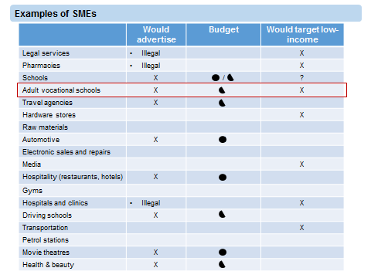
Potential Ad Customer Types

